Slide 1

Google in the Classroom
Peter Beens (@pbeens)
October 2011
http://goo.gl/IHab0
Twitter tag: #ecoo11
cc by-sa

Slide 2
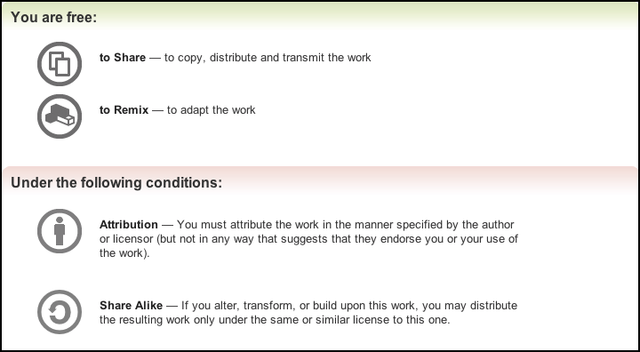
Creative Commons License
This presentation is licensed under the Creative Commons "Attribution-ShareAlike" terms found at http://creativecommons.org/licenses/by-sa/3.0/. This means...
If you find this presentation useful, I'd love to hear how you're using it! You can contact me via email or twitter. Thanks!

Slide 3
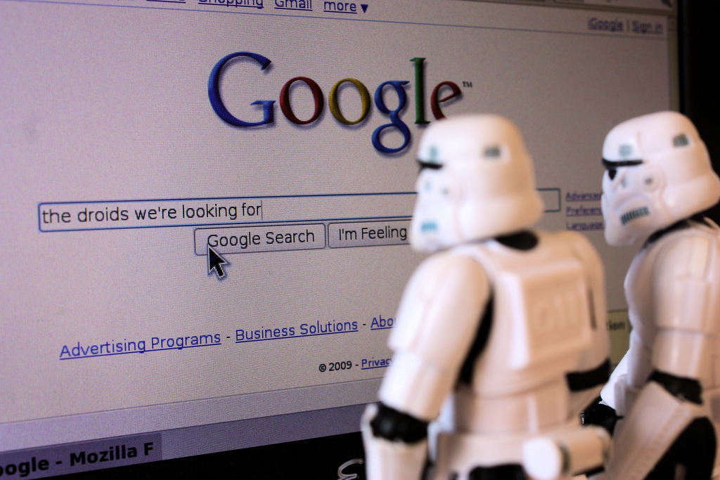
Google is not just a search engine...
Photo courtesy of Stéfan
(flickr, Creative Commons License)

Slide 4
...it's just the tip of the Web 2.0 iceberg!
Google
Sites
Word Processor
Forms
iGoogle
Voice
Gmail
Tasks
Spreadsheet
Calendar
Docs
Books
Groups
PicasaWeb
Drawing
Table
Picasa
Presentation
News Alerts
SketchUp
Building Maker
URL Shortener
Calculator
Disk Space
3D Warehouse
App Inventor
Google Apps for EDU
Chat
Reader
Google+
Gmail Notifier
Search Stories Video Creator
Make Free Phone Calls!

Slide 5
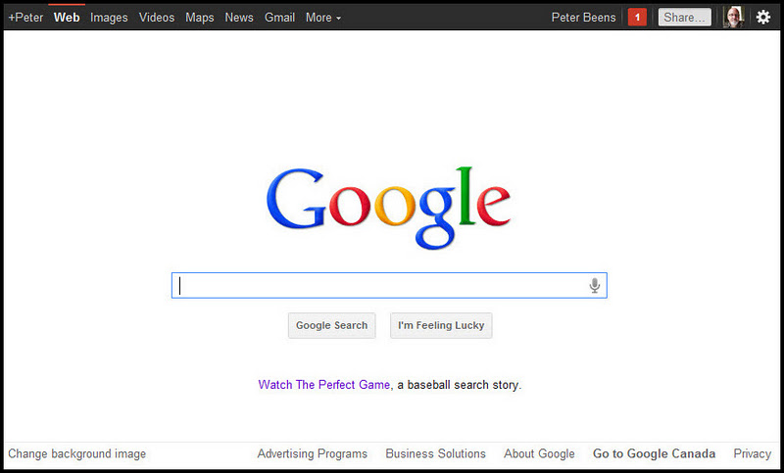
Google
Check out some Google search success stories at http://www.google.com/insidesearch/stories.html
https://www.google.com

Slide 6
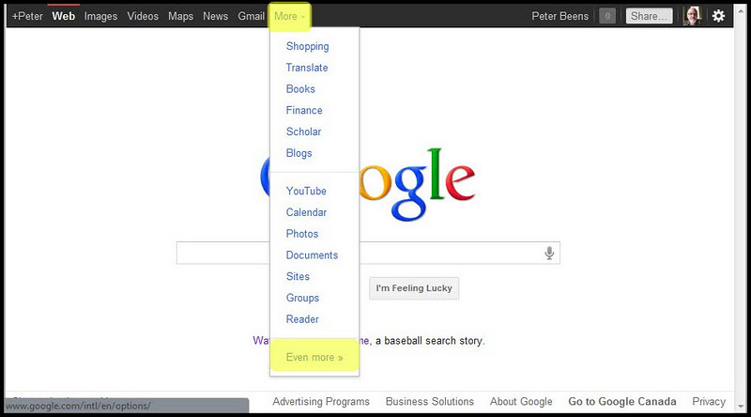
Google: more

Slide 7
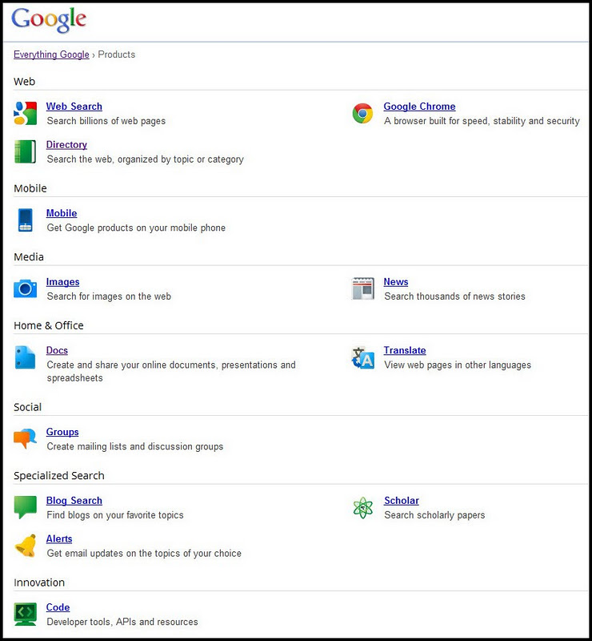
Google: even more!

Slide 8
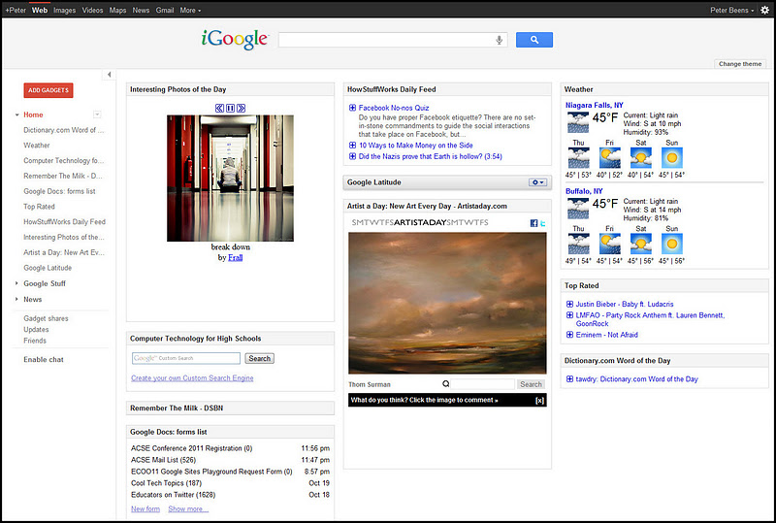
iGoogle
http://www.google.com/ig

Slide 9
Gmail
The best email client available!
A Gmail account becomes your Google ID (Note: you can use an alternative email address to create a Google ID, but for integration with other Google products, this is not recommended)
Stars (priority)
Labels (not folders), which can be coloured for easy identification in inbox (Note: emails can be put in more than one Label)
Filters can be used to sort emails, forward to others, star, label, etc.
Can optionally use a "Priority Inbox"
https://www.gmail.com

Slide 10
Gmail cont'd
Can import from other email accounts (Hotmail, Sympatico, etc.)
Can forward to other email accounts
Can forward to cell phone (SMS)
[10-digit phone number]@pcs.rogers.com
[10-digit phone number]@txt.bell.ca
[10-digit phone number]@msg.telus.com
[10-digit phone number]@fido.ca
Can have multiple return addresses (school board, personal)

Slide 11
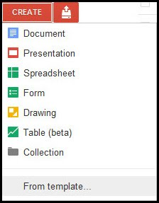
Docs
Word Processor
Presentation
Spreadsheet
Form
Drawing (vector)
Table
Fully collaborative
Files can be private, public, or only shared with specific people or groups
Can upload any type of file (up to 10 GB (!), if not converting to a Google Doc)

Slide 12
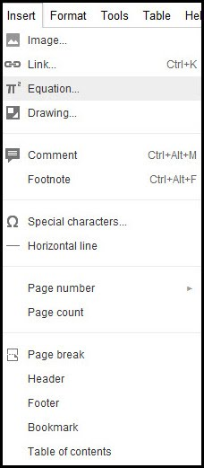
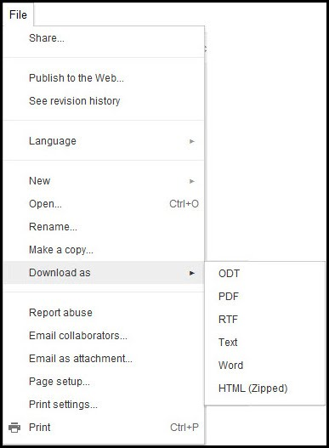
Docs: Word Processor

Slide 13
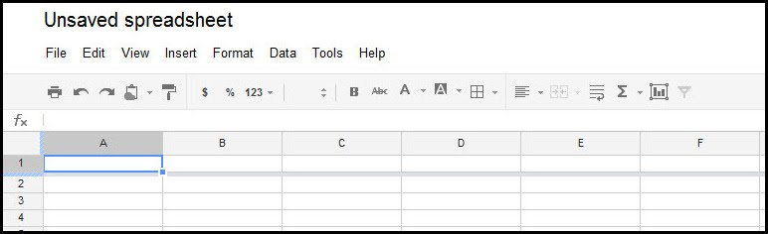
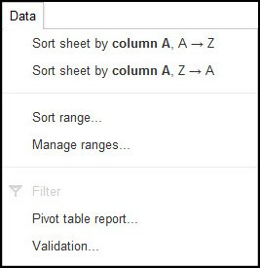
Docs: Spreadsheet

Slide 14
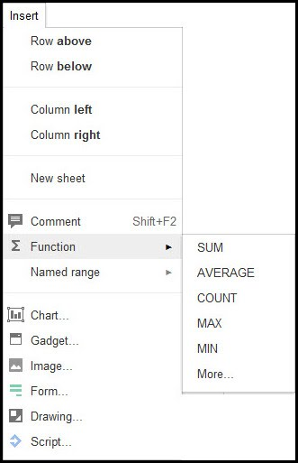
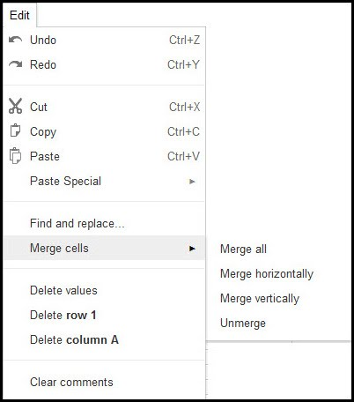
Docs: Spreadsheet (cont'd)

Slide 15
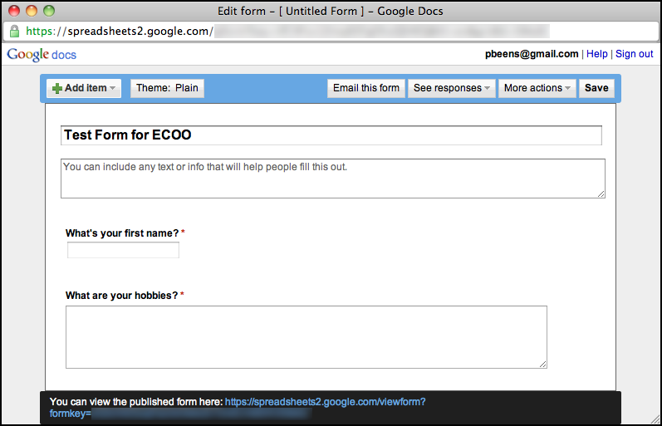
Docs: Forms

Slide 16
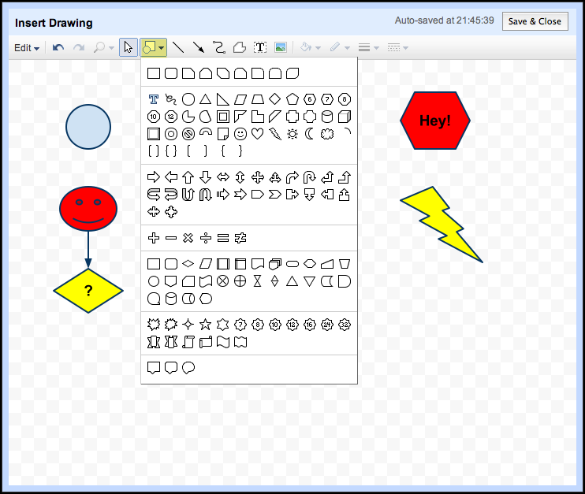
Docs: Diagram

Slide 17
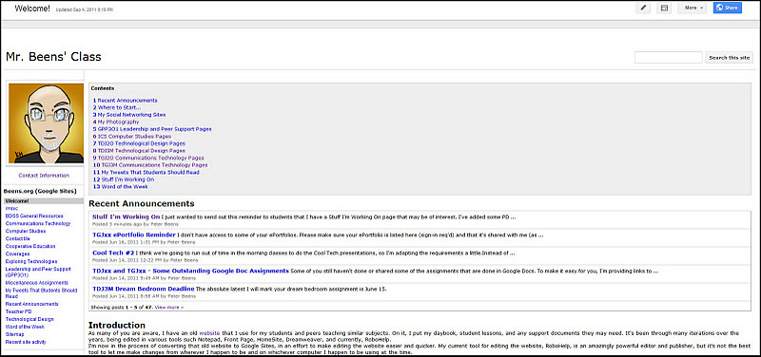
Sites
WYSIWYG website editor
Extremely capable and versatile!
Can be public or private
Collaborative (perfect for sharing with a Google Group)
See my Minds-on-Media resources at http://goo.gl/CkUWd
http://sites.google.com

Slide 18
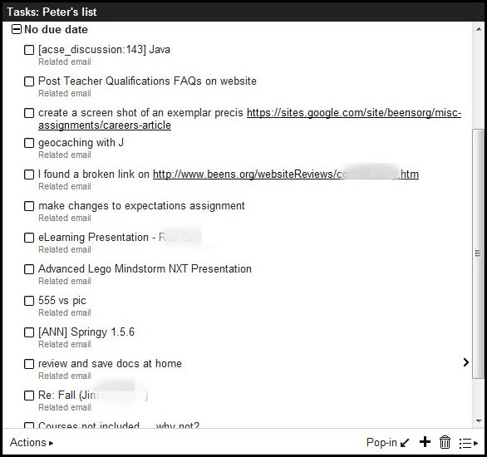
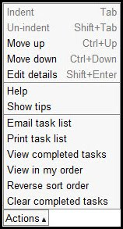
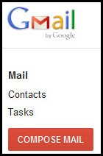
Tasks
Built into Gmail!
Can organize into lists (work, home, spouse, etc.)
Access on your mobile device at mail.google.com/tasks

Slide 19

Control who you communicate with (send or receive), via circles
Public or private to your chosen circles, or extended circles
Video hangouts
Fully searchable
Hash tags are hot links
Previews pictures; has become very popular with photographers (no quota on photos!)
Threads can be "muted"
Chat feature
Messenger service
https://plus.google.com

Slide 20
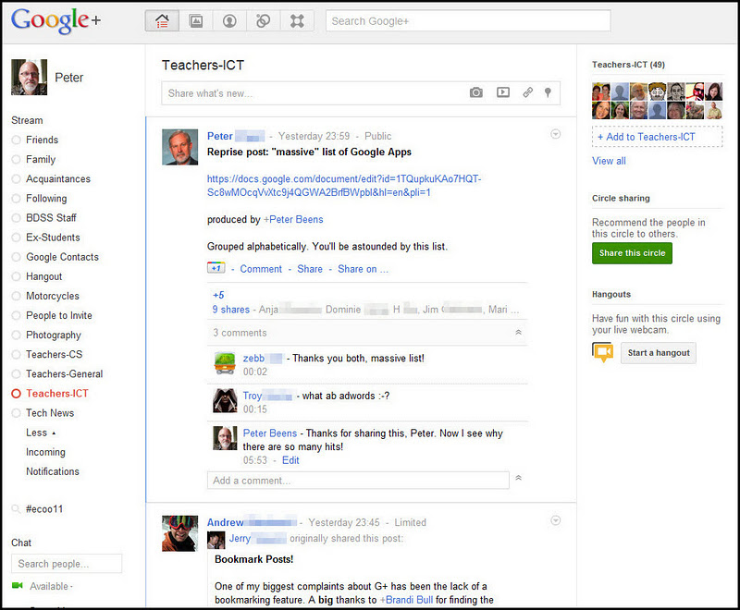
Google+ cont'd

Slide 21
Books
Access full copies of non-copyrighted materials, and previews of copyrighted material
Search for specific content (and bookmark or share it!)
Example Search Result
Select "Full View" in Advanced Search to restrict search to books that available in their entirety
http://books.google.com/

Slide 22
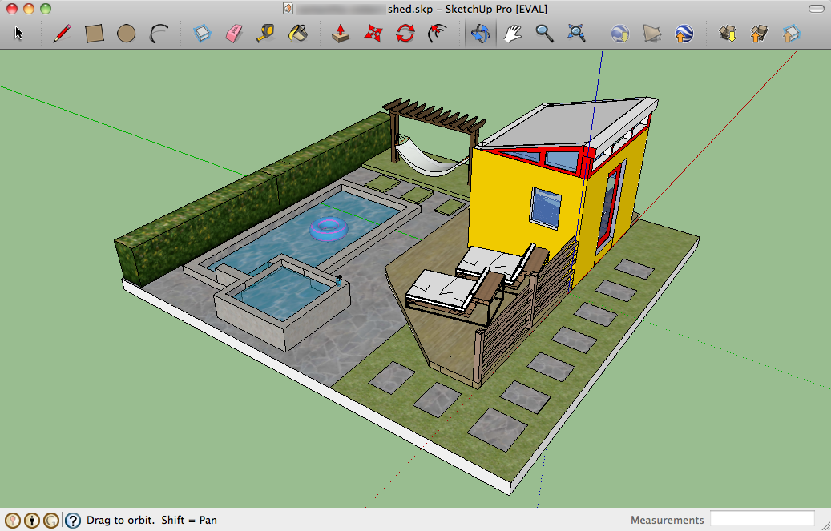
SketchUp
For drawing 3D models and drawings
Free and Pro versions (teachers get pro license for free!)
http://sketchup.google.com/
Excellent teaching resources available at http://www.3dvinci.net

Slide 23
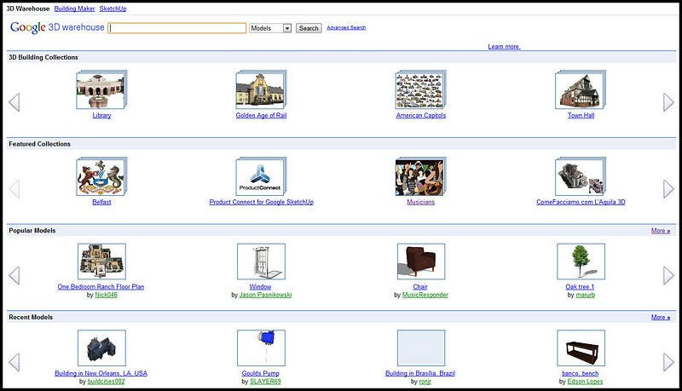
SketchUp: 3D Warehouse
http://sketchup.google.com/3dwarehouse/

Slide 24
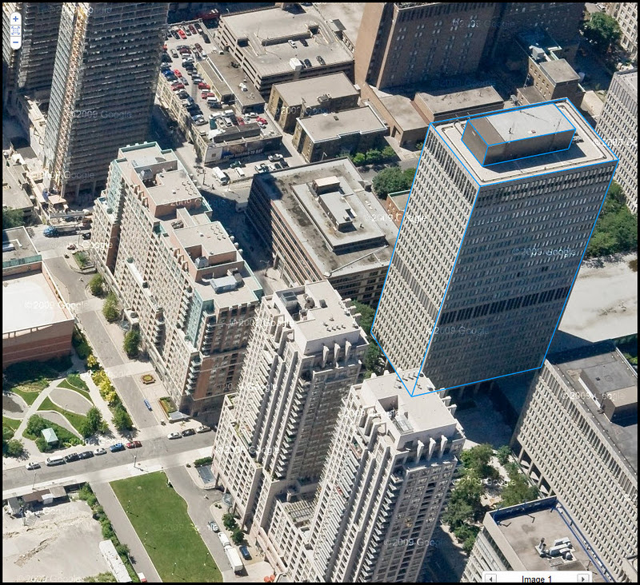
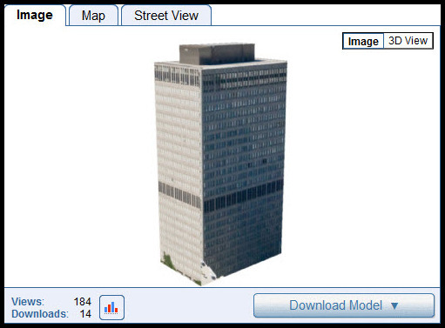
SketchUp: Building Maker
http://sketchup.google.com/3dwh/buildingmaker.html

Slide 25
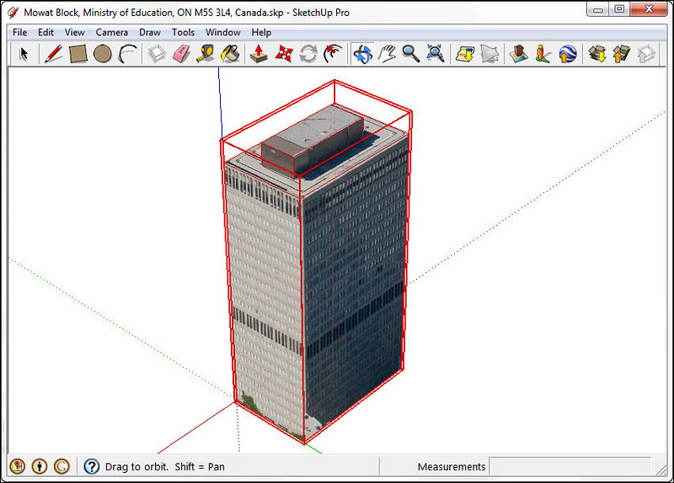

Slide 26
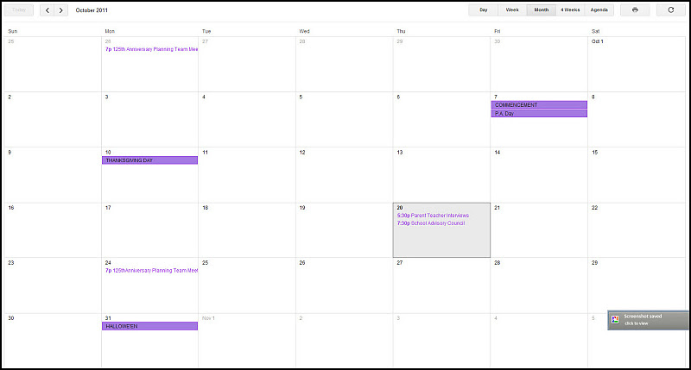
Calendar
Can be public or private
Can share for editing or viewing
Can have multiple calendars (work, family)
http://calendar.google.com

Slide 27
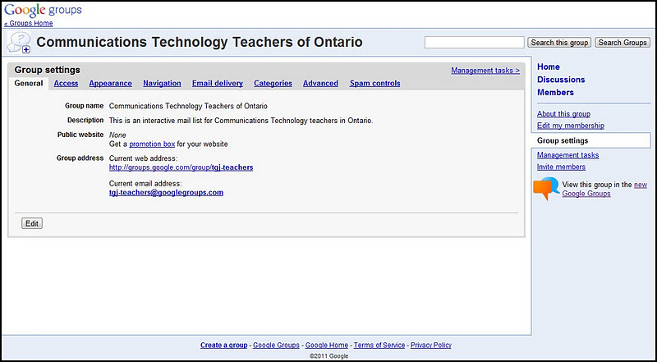
Groups
Create private a private mailing list for your class
Group address can be used for emailing to everyone, and to share a Google Doc for editing, viewing, or commenting
Choice of all emails, online only, or daily digest
http://groups.google.com/

Slide 28
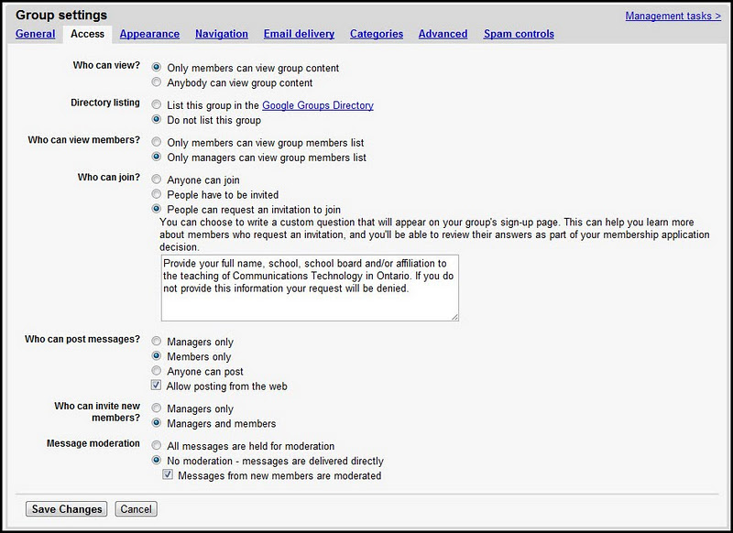
Groups - Access Settings

Slide 29
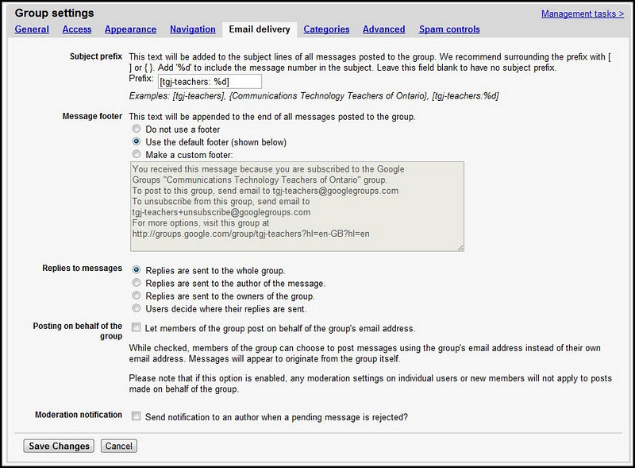
Groups - Email Delivery Settings

Slide 30

Reader
"RSS Reader" -- Bring the news to you!
Share articles in your Reader account with your students
Video: Google Reader in Plain English
http://www.google.com/reader

Slide 31
Picasa
Excellent photo organizer & non-destructive editor
Can tag images
Can recognize & catalog people
Can geo-tag photos
Can upload to PicasaWeb
Can email to others using your Gmail account & contacts
Can export in various sizes
Can make video slideshows
Can make "faces" movies
Can make gift CDs
Can upload to flickr, Facebook, Blogger
http://picasa.google.com/

Slide 32
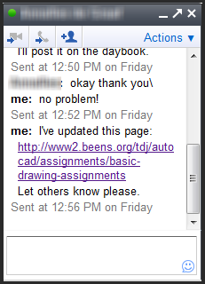
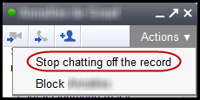
Chat
Built into Gmail
Tip: Make sure chat conversations are "on the record"

Slide 33
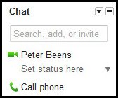
Call Phone
Integrated into Gmail, in the Chat area
Call anywhere in North America, for free
Use your webcam mic and speakers or a headset
Typical rates:
China 2¢ / minute (incl. mobile)
France 2¢ / minute (mobile: 8¢ / minute)
Russia: 2¢ / minute (incl. mobile)
Mexico: 2¢-10¢ / minute (mobile: 19¢ / minute)
See https://www.google.com/voice/rates for more rates

Slide 34
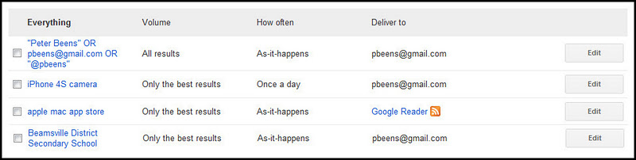
Google Alerts
Vanity search (see who's writing about you!)
Monitor the Web for interesting new content
Search for topics related to your subject
Search for your school in the news!
http://alerts.google.com

Slide 35
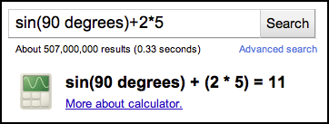
Calculator
Just enter your expression in Google!
Accepts, +, -, /, *, times, divided by, % of, mod or %, ^ or **, the nth root of, reciprocal of, sin, cos, tan (etc.), ln, log, lg, !, n degrees in radians, units of measure and conversions (lots!), numbering system conversions, physical constants, currency conversions, sunrise, sunset
See http://www.googleguide.com/help/calculator.html for reference

Slide 36
Gmail Notifier
Provides notifications when an email comes in
Can make Gmail the default email client
http://toolbar.google.com/gmail-helper

Slide 37
Google Apps for EDU
Let Google host your files and emails, and administer your accounts!
Free
Includes
Gmail
Docs
Calendar
Groups
Sites
Maps
Blogger
YouTube
...and much more!
http://www.google.com/apps/intl/en/edu/

Slide 38
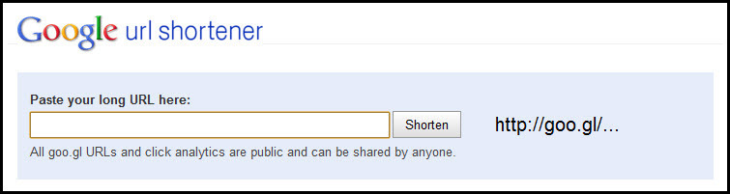
URL Shortener
http://goo.gl/

Slide 39
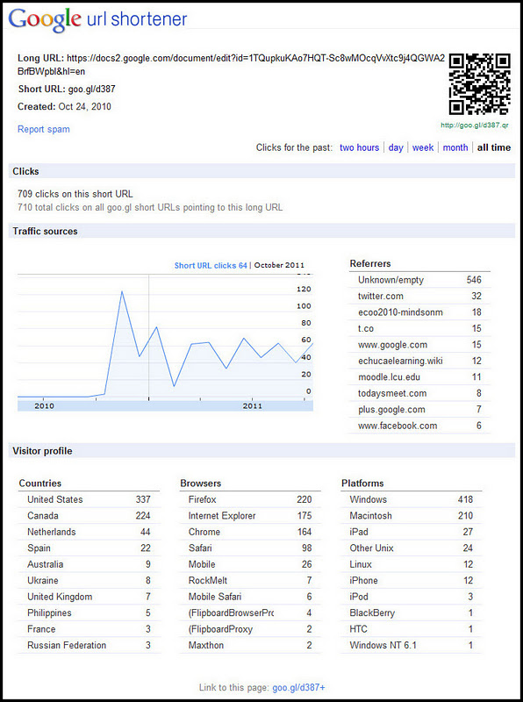

Slide 40
Disk Storage (your disk quota)
Gmail: ~7 GB
Docs: 1 GB, but converted docs do not count towards your space
Sites: 100 MB
PicasaWeb: 1 GB
Google+: unlimited?
Check your usage and upgrade at
https://accounts.google.com/PurchaseStorage

Slide 41
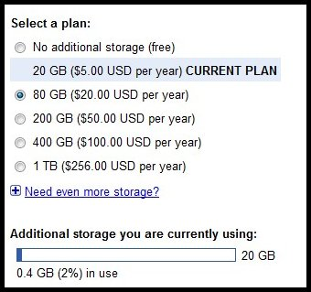
Need More Disk Space?

Slide 42
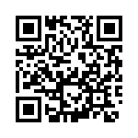
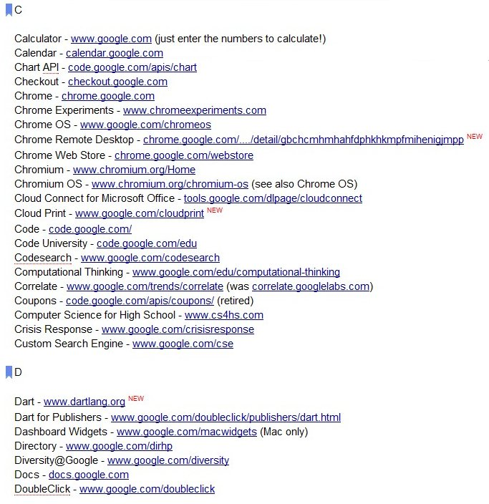
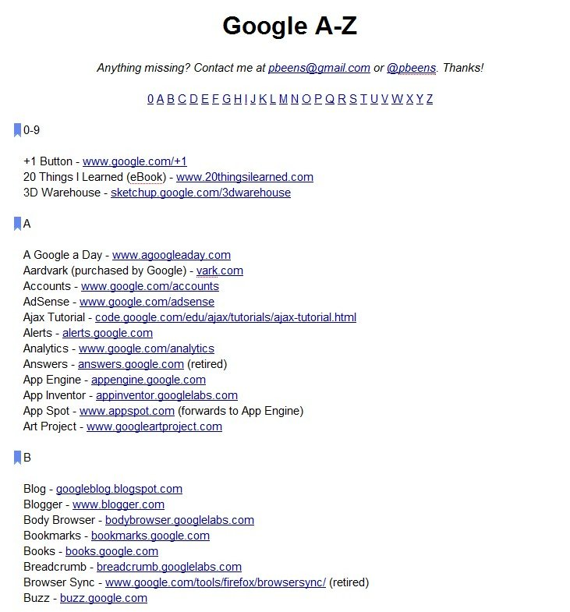
Google A-Z Google Doc
http://goo.gl/d387

Slide 43

Thanks!
Peter Beens
Email: pbeens@gmail.com
Web: http://www2.beens.org
Blog: http://blog.beens.org
Twitter: http://twitter.com/pbeens
Flickr: http://www.flickr.com/photos/pbeens/
http://goo.gl/IHab0

